Slide 1

POVERTY

Slide 2
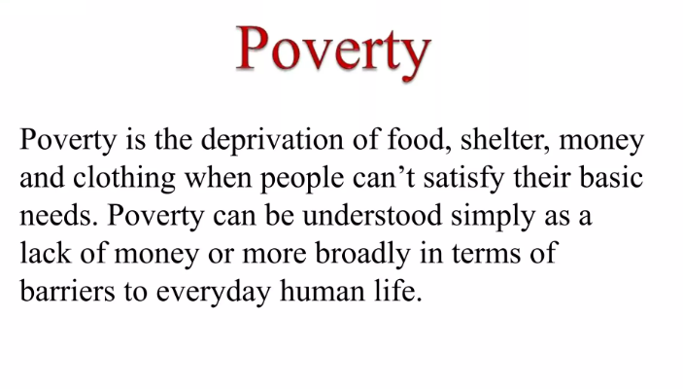

Slide 3
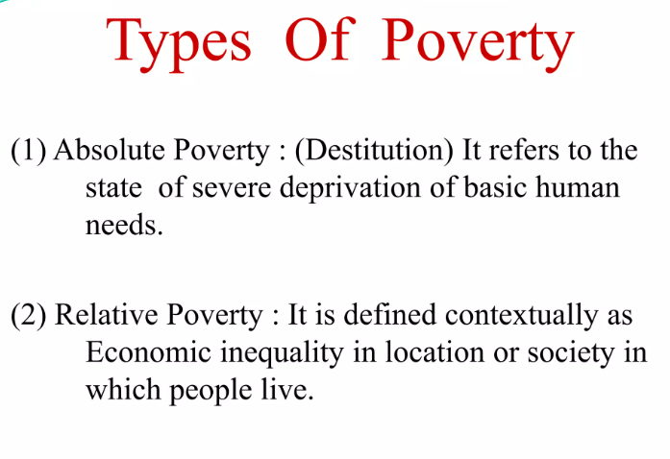

Slide 4
Four Questions About Poverty
1 Absolute and/or relative poverty?
2 Income and/or opportunities?
3 Individual and/or social causes?
4 Material and/or social consequences?
Notes:
Four questions about poverty 1 Absolute and/or relative poverty? Where is the ‘poverty line’? Should it be the minimum income necessary for survival, or should it be the amount of money to have a generally acceptable standard of living in one’s society? Who decides how much money is needed for either of these poverty lines? How? (For example, what counts as part of a ‘generally acceptable standard’ – subscription television channels, holidays, new clothes or second hand, alcohol?) 2 Income and/or opportunities? Should poverty be measured simply in terms of the income and financial assets of an individual or household, or should it include other factors like educational attainment, health, employment, standard of housing? Access to services such as decent schools and health care? Quality of neighbourhood life, low crime rates? 3 Individual and/or social causes? How do we understand the causes of poverty? Individual misfortune, individual choices? Intergenerational or community attitudes and cultures? Lack of effective services and support? Wider structural causes (e.g. social class, gender, race)? The exploitative relations of capitalism
4 Material and/or social consequences? Do we measure poverty solely in terms of the material impact (poor diet, clothing, health, housing, education), or do we also look at the impact on social relations (shame and stigma, disrespect and humiliation, powerlessness, stereotyping)? Lister’s (2004) ‘wheel of poverty’ has the material aspects at the centre and the non-material, symbolic and relational aspects round the edge

Slide 5
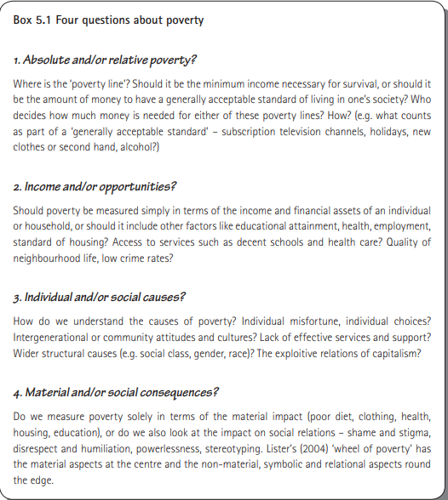

Slide 6
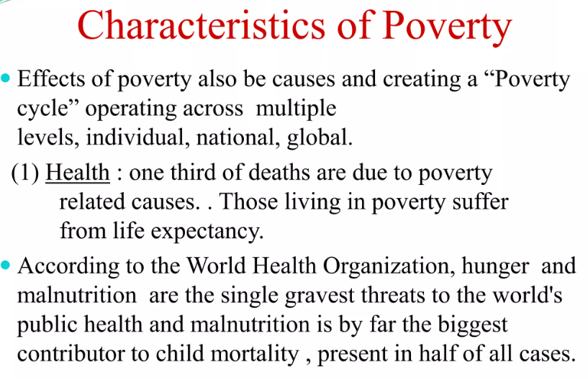

Slide 7
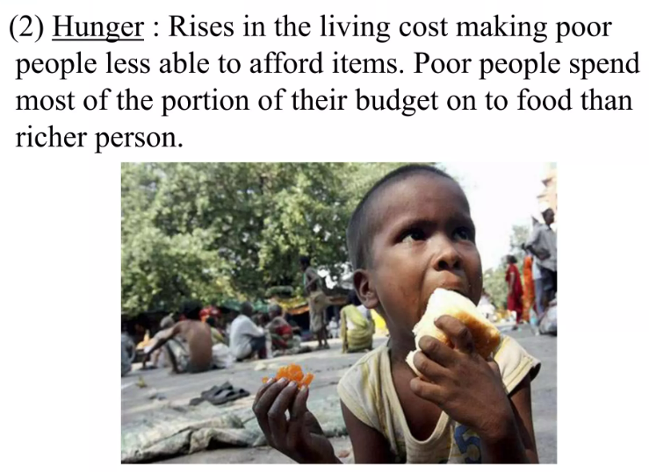

Slide 8
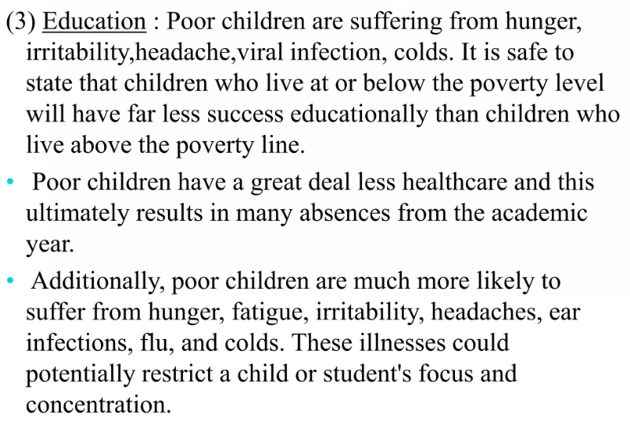

Slide 9
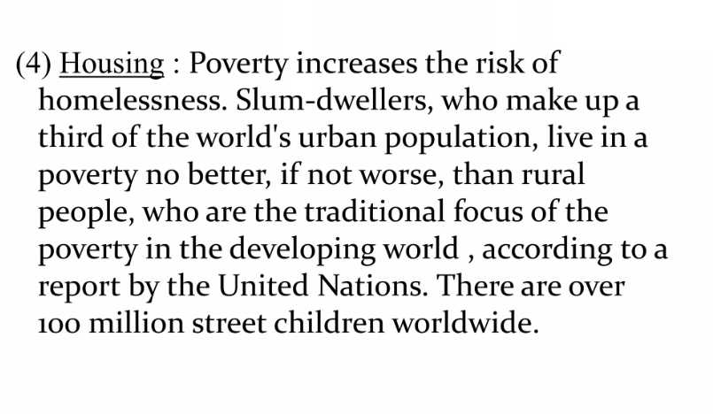

Slide 10
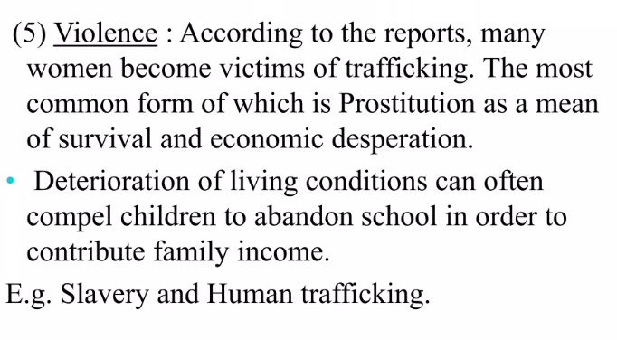

Slide 11
Reduce Poverty
Support
Opportunity
Behavior
Notes:
Support includes improved financial help, such as raising benefit levels, improving the operation of the tax credit and benefit systems, and raising the minimum wage. It also involves skilled support and guidance for helping people find and start jobs, and help for gaining skills and Key issues 96 97 Inequality and poverty qualifications. This echoes Harker (2006: 61), who argues for a welfare to work system that is more tuned into parents’ needs and helps them to make progress in jobs, not just to find jobs. • Opportunity includes good-quality childcare, jobs with family-friendly hours, flexible working and jobs which offer training and progression. • Behaviour is important too, but the question is how can the government facilitate and encourage the behaviours it wants (such as more parents in work, or gaining skills)? This needs a shift to a partnership approach, recognising people’s different circumstances without blaming and punishing them

